Slide 1

A Normalisation Example
Mark Kelly
McKinnon Secondary College
Vceit.com
Based on work by Robert Timmer-Arends

Slide 2
Problem Without Normalization
S_id | S_Name | S_Address | Subject_opted
401 | Adam | Noida | Bio
402 | Alex | Panipat | Maths
403 | Stuart | Jammu | Maths
404 | Adam | Noida | Physics
Updation Anomaly : To update address of a student who occurs twice or more than twice in a table, we will have to update S_Address column in all the rows, else data will become inconsistent.
Insertion Anomaly : Suppose for a new admission, we have a Student id(S_id), name and address of a student but if student has not opted for any subjects yet then we have to insert NULL there, leading to Insertion Anamoly.
Deletion Anomaly : If (S_id) 401 has only one subject and temporarily he drops it, when we delete that row, entire student record will be deleted along with it.
Notes:
Without Normalization, it becomes difficult to handle and update the database, without facing data loss. Insertion, Updation and Deletion Anamolies are very frequent if Database is not Normalized. To understand these anomalies let us take an example of Student table

Slide 3
First Normal Form (1NF)
A row of data cannot contain repeating group of data i.e each column must have a unique value. Each row of data must have a unique identifier i.e Primary key. For example consider a table which is not in First normal form

Slide 4

Take the following table.
StudentID is the primary key.
Is it 1NF?

Slide 5
No. There are repeating groups (subject, subjectcost, grade)
How can you make it 1NF?

Slide 6

Create new rows so each cell contains only one value
But now look – is the studentID primary key still valid?

Slide 7
No – the studentID no longer uniquely identifies each row
You now need to declare studentID and subject together to uniquely identify each row.
So the new key is StudentID and Subject.

Slide 8
Second Normal Form (2NF)
A table to be normalized to Second Normal Form there must not be any partial dependency of any column on primary key. It means that for a table that has concatenated primary key, each column in the table that is not part of the primary key must depend upon the entire concatenated key for its existence. If any column depends oly on one part of the concatenated key, then the table fails Second normal form.

Slide 9
So. We now have 1NF.
Is it 2NF?

Slide 10
Studentname and address are dependent on studentID (which is part of the key)
This is good.
But they are not dependent on Subject (the other part of the key)

Slide 11
And 2NF requires…
All non-key fields are dependent on the ENTIRE key (studentID + subject)

Slide 12
So it’s not 2NF
How can we fix it?

Slide 13
Make new tables
Make a new table for each primary key field
Give each new table its own primary key
Move columns from the original table to the new table that matches their primary key…

Slide 14
Step 1
STUDENT TABLE (key = StudentID)

Slide 15

Step 2
STUDENT TABLE (key = StudentID)
SUBJECTS TABLE (key = Subject)

Slide 16



Step 3
STUDENT TABLE (key = StudentID)
SUBJECTS TABLE (key = Subject)
RESULTS TABLE (key = StudentID+Subject)

Slide 17
Step 3
STUDENT TABLE (key = StudentID)
SUBJECTS TABLE (key = Subject)
RESULTS TABLE (key = StudentID+Subject)

Slide 18
Step 4 - relationships
STUDENT TABLE (key = StudentID)
SUBJECTS TABLE (key = Subject)
RESULTS TABLE (key = StudentID+Subject)

Slide 19
Step 4 - cardinality
STUDENT TABLE (key = StudentID)
1
Each student can only appear ONCE in the student table
SUBJECTS TABLE (key = Subject)
RESULTS TABLE (key = StudentID+Subject)

Slide 20
Step 4 - cardinality
STUDENT TABLE (key = StudentID)
1
SUBJECTS TABLE (key = Subject)
1
Each subject can only appear ONCE in the subjects table
RESULTS TABLE (key = StudentID+Subject)

Slide 21
Step 4 - cardinality
STUDENT TABLE (key = StudentID)
1
SUBJECTS TABLE (key = Subject)
1
A subject can be listed MANY times in the results table (for different students)
8
RESULTS TABLE (key = StudentID+Subject)

Slide 22
Step 4 - cardinality
STUDENT TABLE (key = StudentID)
1
SUBJECTS TABLE (key = Subject)
1
A student can be listed MANY times in the results table (for different subjects)
8
8
RESULTS TABLE (key = StudentID+Subject)

Slide 23
A 2NF check
STUDENT TABLE (key = StudentID)
1
SUBJECTS TABLE (key = Subject)
1
SubjectCost is only dependent on the primary key,
Subject
8
8
RESULTS TABLE (key = StudentID+Subject)

Slide 24
A 2NF check
STUDENT TABLE (key = StudentID)
1
SUBJECTS TABLE (key = Subject)
1
8
8
Grade is only dependent on the primary key (studentID + subject)
RESULTS TABLE (key = StudentID+Subject)

Slide 25
A 2NF check
STUDENT TABLE (key = StudentID)
1
Name, Address are only dependent on the primary key
(StudentID)
SUBJECTS TABLE (key = Subject)
1
8
8
RESULTS TABLE (key = StudentID+Subject)

Slide 26
But is it 3NF?
STUDENT TABLE (key = StudentID)
1
So it is 2NF!
SUBJECTS TABLE (key = Subject)
1
8
8
RESULTS TABLE (key = StudentID+Subject)

Slide 27
Third Normal Form (3NF)
Third Normal form applies that every non-prime attribute of table must be dependent on primary key. The transitive functional dependency should be removed from the table.

Slide 28
A 3NF check
STUDENT TABLE (key = StudentID)
1
Oh oh…
What?
SUBJECTS TABLE (key = Subject)
1
8
8
RESULTS TABLE (key = StudentID+Subject)

Slide 29
A 3NF check
STUDENT TABLE (key = StudentID)
1
HouseName is dependent on both StudentID + HouseColour
SUBJECTS TABLE (key = Subject)
1
8
8
RESULTS TABLE (key = StudentID+Subject)

Slide 30
A 3NF check
STUDENT TABLE (key = StudentID)
1
Or HouseColour is dependent on both StudentID + HouseName
SUBJECTS TABLE (key = Subject)
1
8
8
RESULTS TABLE (key = StudentID+Subject)

Slide 31
A 3NF check
STUDENT TABLE (key = StudentID)
1
But either way,
non-key fields are dependent on MORE THAN THE PRIMARY KEY (studentID)
SUBJECTS TABLE (key = Subject)
1
8
8
RESULTS TABLE (key = StudentID+Subject)

Slide 32
A 3NF check
STUDENT TABLE (key = StudentID)
1
And 3NF says that non-key fields must depend on nothing but the key
SUBJECTS TABLE (key = Subject)
1
8
8
RESULTS TABLE (key = StudentID+Subject)

Slide 33
A 3NF check
STUDENT TABLE (key = StudentID)
1
WHAT DO WE DO?
SUBJECTS TABLE (key = Subject)
1
8
8
RESULTS TABLE (key = StudentID+Subject)

Slide 34

Again, carve off the offending fields
1
SUBJECTS TABLE (key = Subject)
8
8
1
RESULTS TABLE (key = StudentID+Subject)

Slide 35

A 3NF fix
1
SUBJECTS TABLE (key = Subject)
8
8
1
RESULTS TABLE (key = StudentID+Subject)

Slide 36
A 3NF fix
8
1
1
SUBJECTS TABLE (key = Subject)
8
8
1
RESULTS TABLE (key = StudentID+Subject)

Slide 37
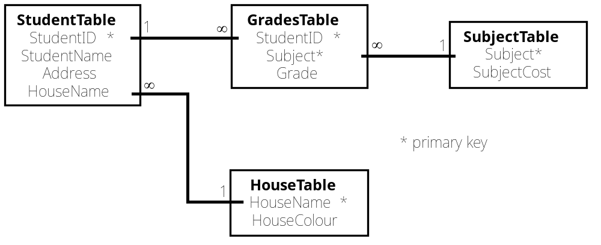
A 3NF win!
8
1
1
8
8
1
SUBJECTS TABLE (key = Subject)
RESULTS TABLE (key = StudentID+Subject)
Or…

Slide 38
The Reveal
Before…
After…
1
8
1
1
8
8
SUBJECTS TABLE (key = Subject)
RESULTS TABLE (key = StudentID+Subject)

